Slide 1
D2DC System
by
Model Tinkerers Karukkuvel Raj D (d.karukkuvelraj@gmail.com)

Slide 2
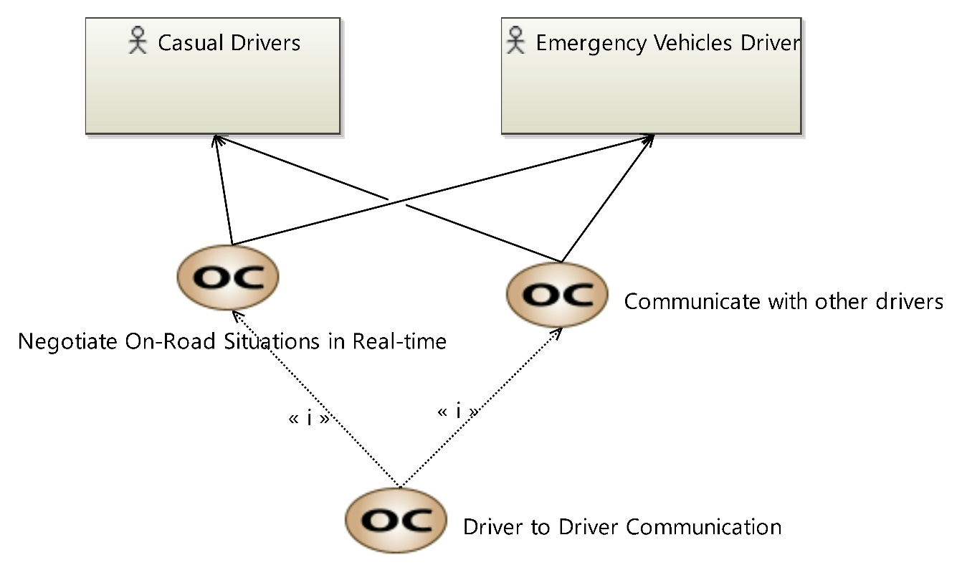
[OCB] Operations Capabilities Blank

Slide 3
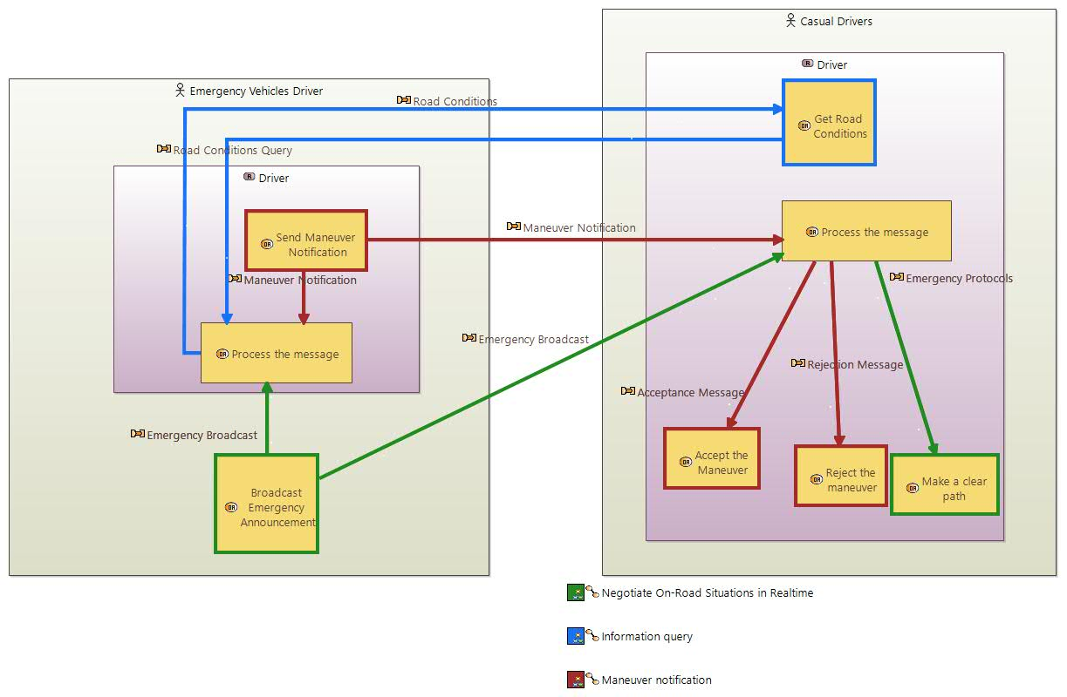
Operational Architecture

Slide 4
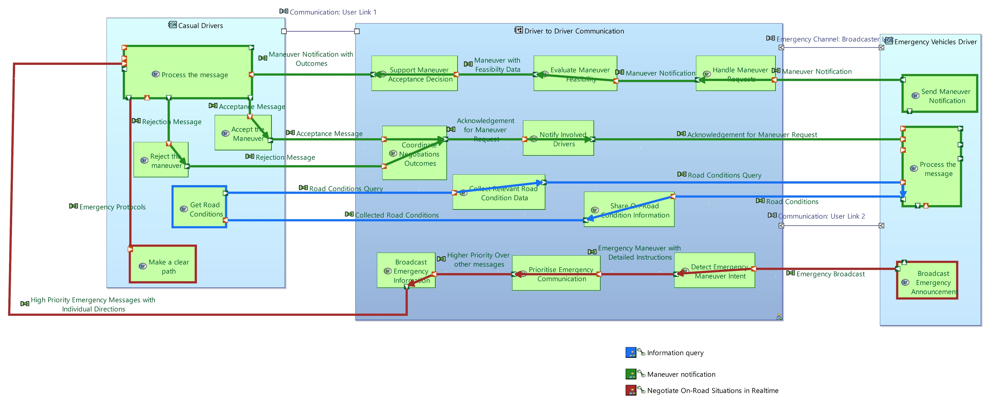
System Architecture

Slide 5
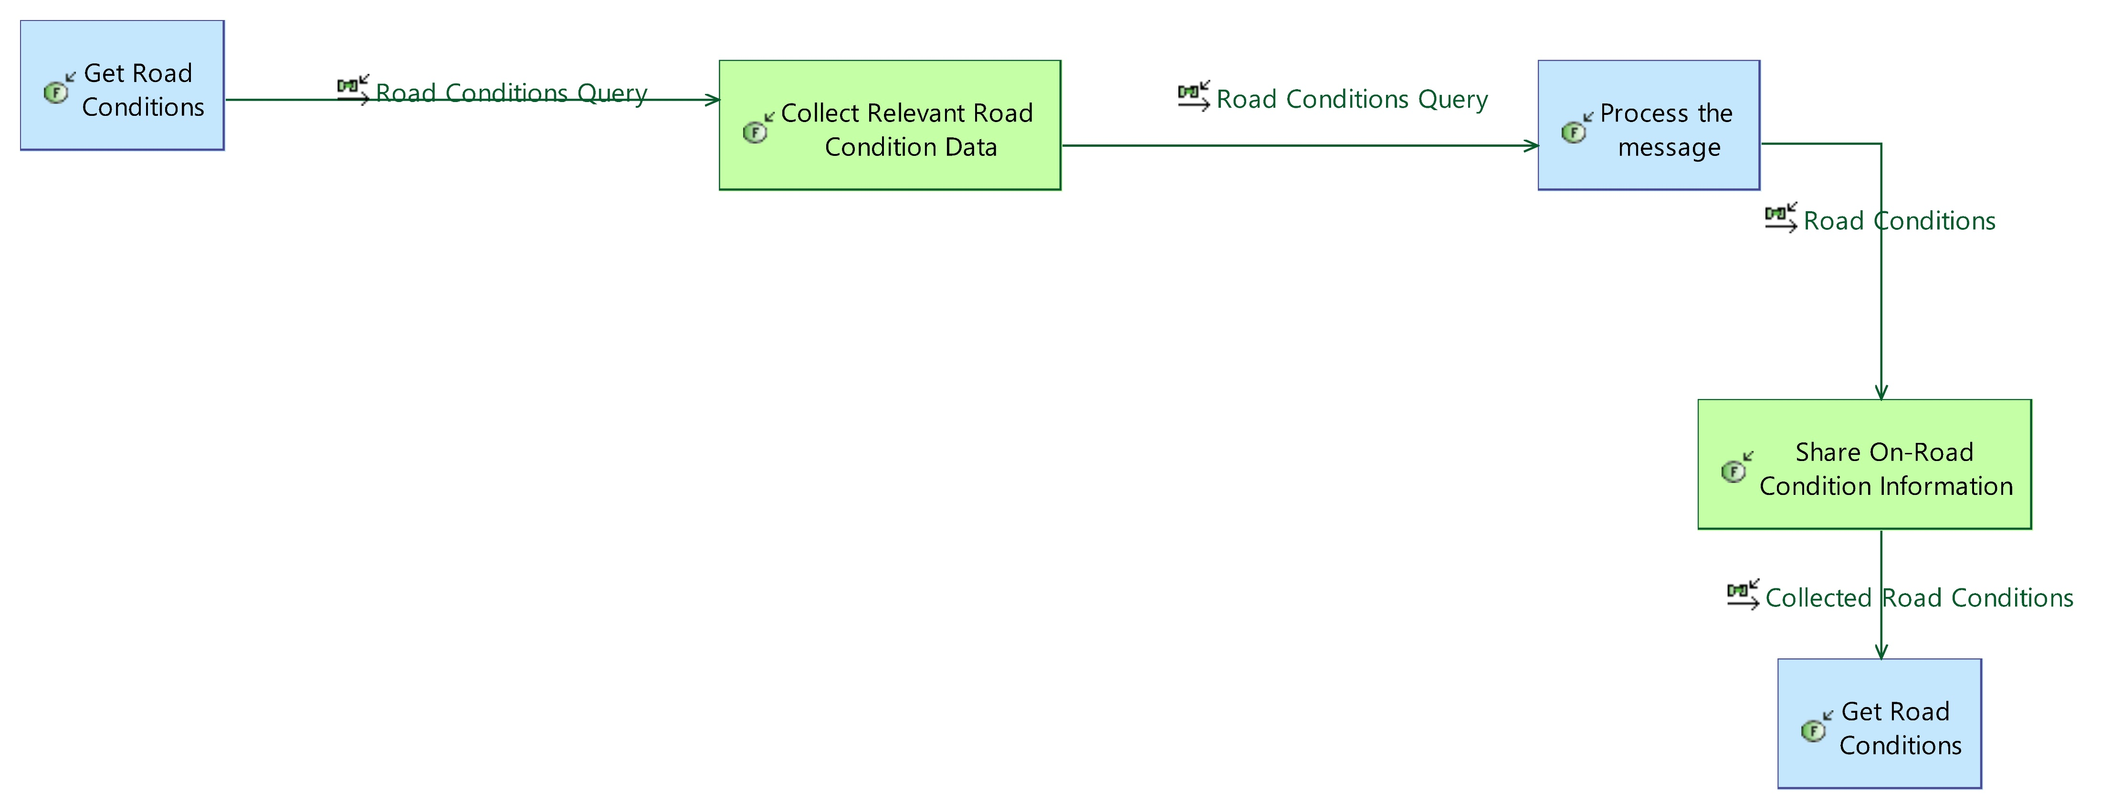
[SFCD] Information Query

Slide 6
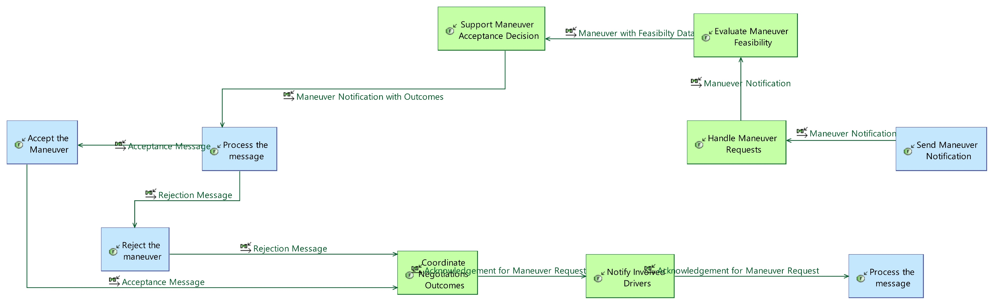
[SFCD] Maneuver Notification

Slide 7
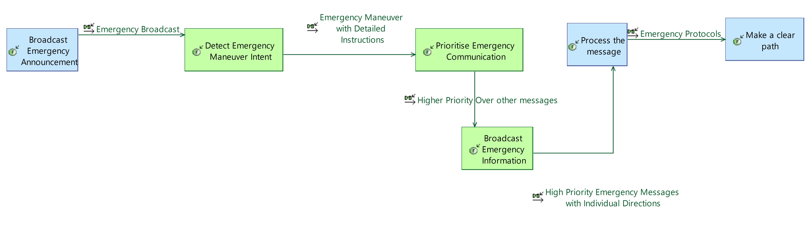
[SFCD] Negotiate On-Road Situations in Real time

Slide 8
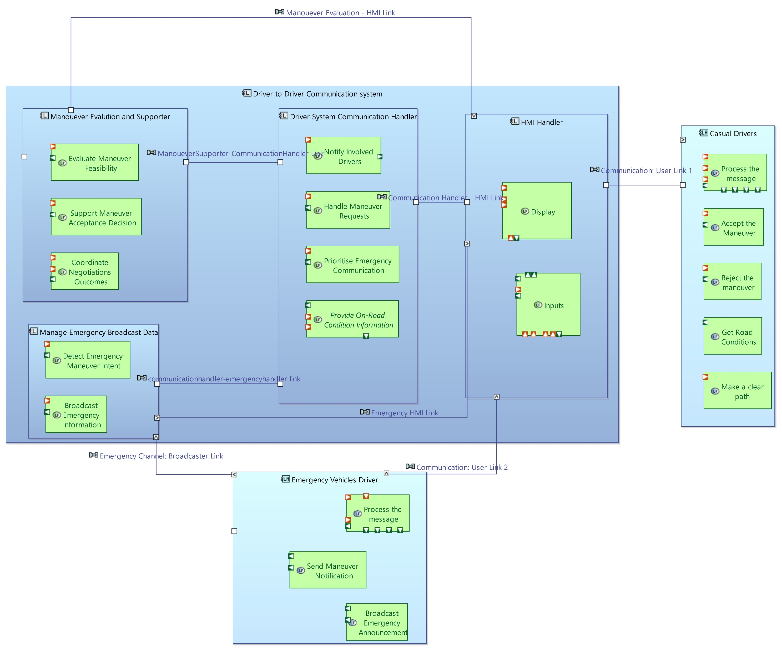
Logical Architecture

Slide 9
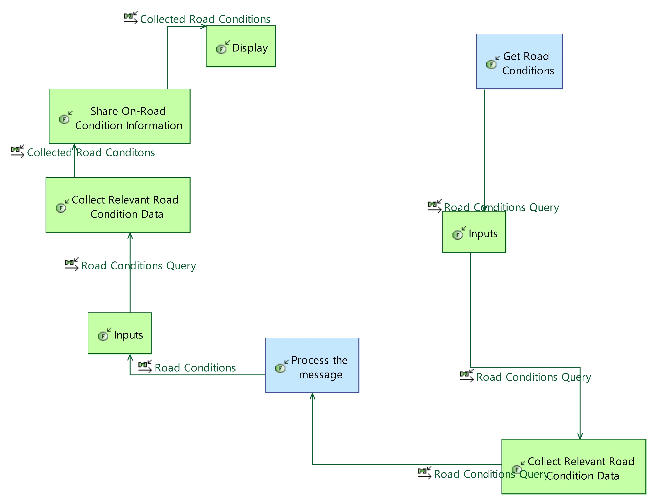
[LFCD] Information Query

Slide 10
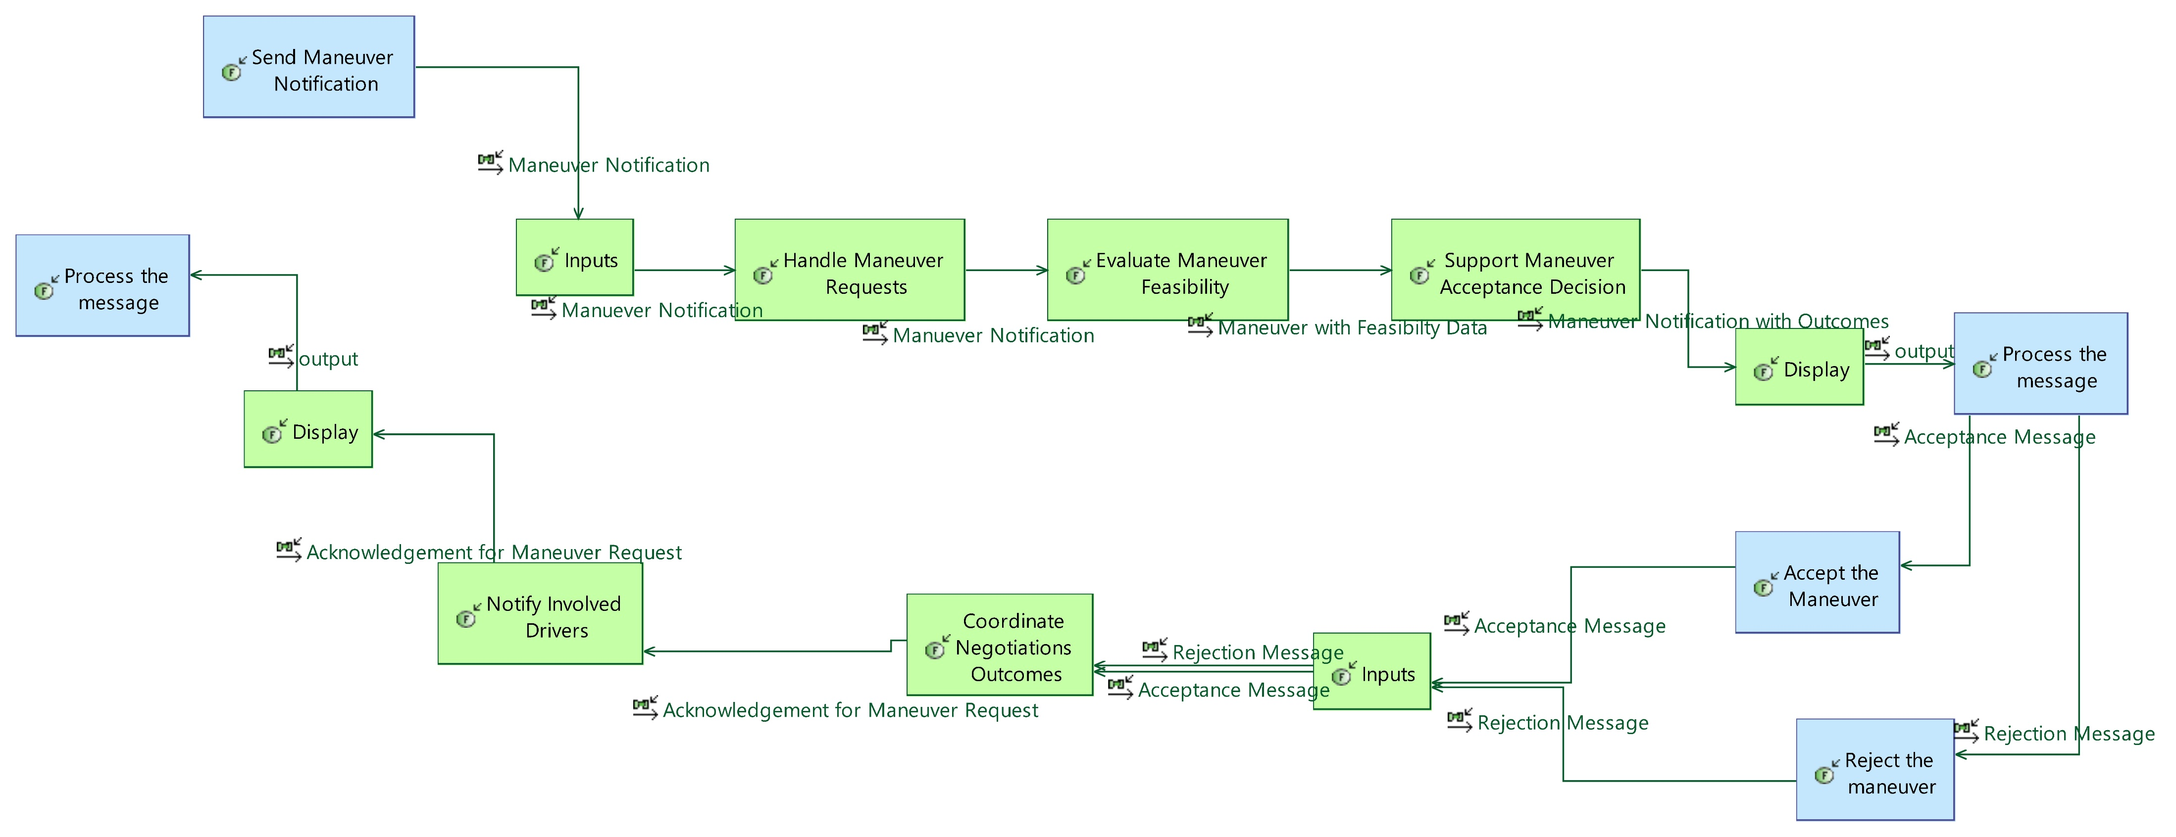
[LFCD] Maneuver Notification

Slide 11
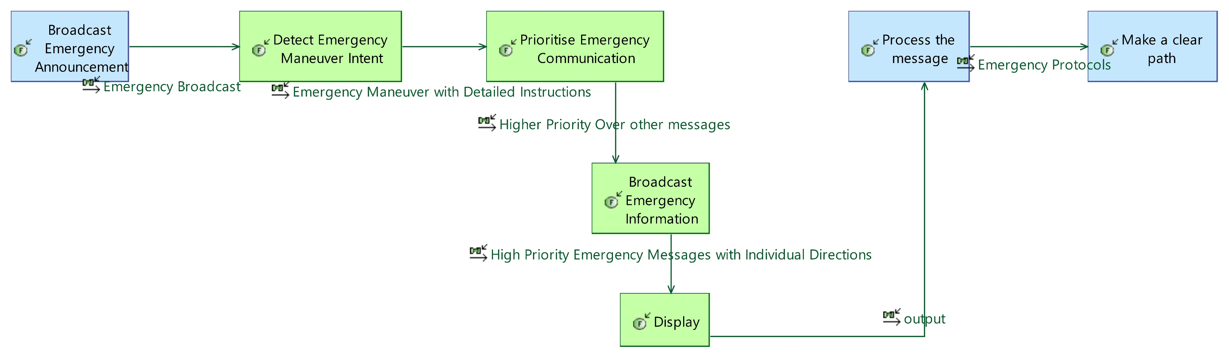
[LFCD] Negotiate On-Road Situation in Realtime

Slide 12
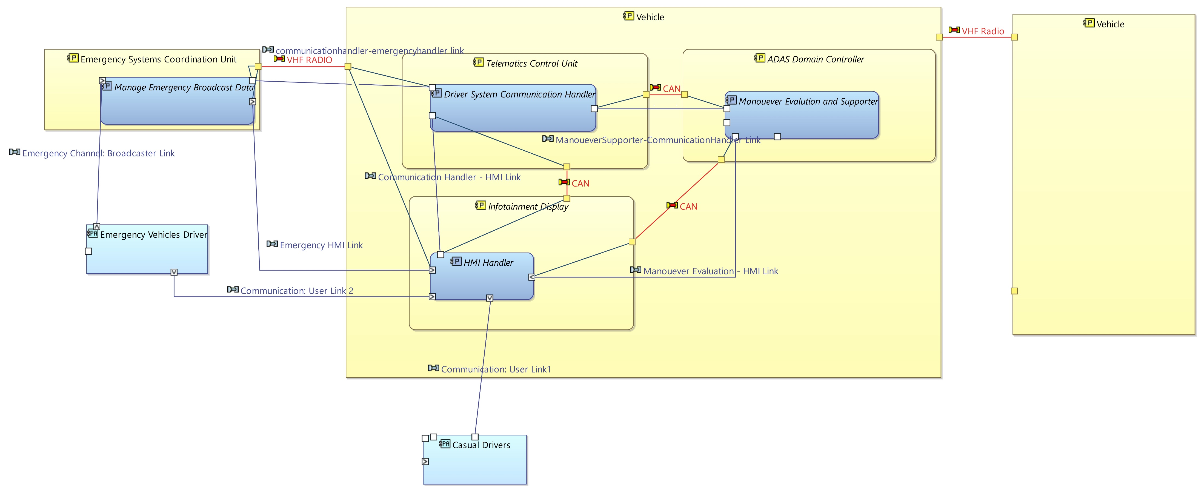
Physical Architecture

Slide 13
Thank You
Note: Models are hosted on Github: https://github.com/karukkuvelaero/MBSE-D2DC-Challenge.git

